Slide 1
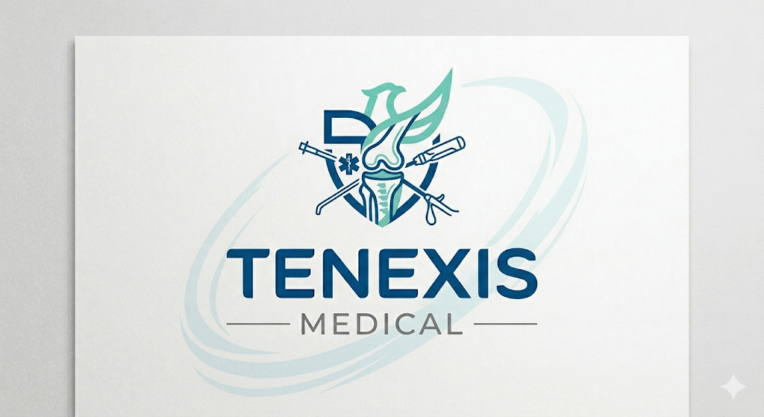
A MODERN C LI N ICAL REVO LUTION
Providing End-to-End Operating Room Support & Best-in-Class Orthopedic Products

Slide 2
Meet the Founders
Combining Elite Clinical Operations & Athletic Recovery Expertise

Slide 3
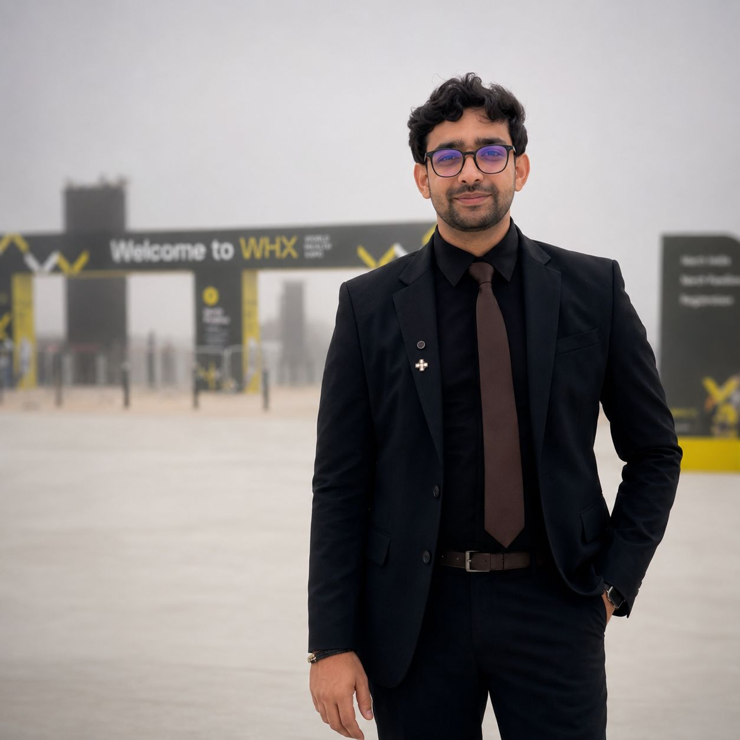
Taha: Global Clinical Specialist
Elite Operating Room Expertise
Taha brings over 10 years of intensive, global experience within the orthopedic sector representing tier-one international biomedical brands.
Having served with giants like Medtronic, Arthrex, Conmed, and Meril Life Sciences, he has technical and clinical mastery over Arthroplasty and Arthroscopy.
H is deep understanding of surgical dynamics and close relationships with surgeons across Europe, Africa, the Middle East, and Asia drive Tenexis' operational excellence.

Slide 4
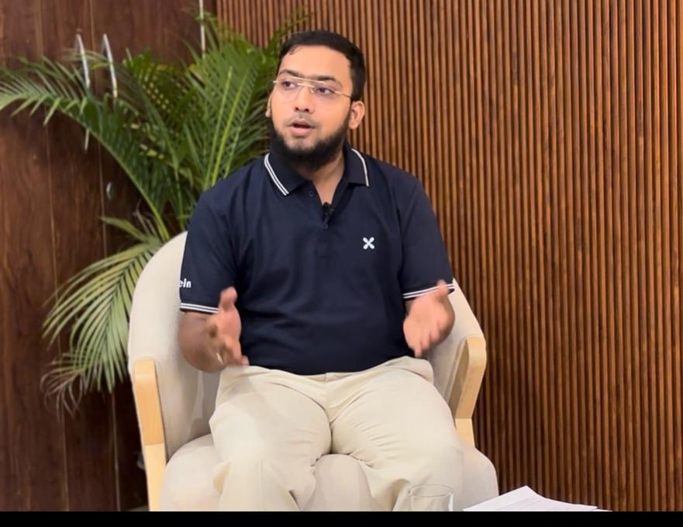
Dr. Khan: Rehabilitation Expert
Post-Operative Recovery Leadership
Dr. Abdul Ahad Khan possesses a strong academic background as a physiotherapist (BPT) and runs a highly successful chain of modern Rehabilitation centers.
His day-to-day work involves managing athletic conditioning and recovery, working closely with world-class competitive athletes to restore peak performance.
His holistic insight ensures that Tenexis Medical products are engineered not just for successful surgeries, but for faster, more effective patient recovery timelines.

Slide 5
The Orthopedic Gap
Why Traditional Implant Distribution Models Are Failing Our Doctors

Slide 6
Implant Provider vs. Partner
The Tenexis Partnership Model
Integrated Service Support: We supply best-in-class implants accompanied by fully trained technical staff who assist throughout the procedure.
Surgeon-Centric Care: By streamlining instrumentation and offering hand-to-hand OR support, we make the surgeon's life easier, more predictable, and highly efficient.
The Traditional Industry Gaps
Pure Implants, Zero Assistance: Standard distributors focus solely on drop-shipping hardware. They leave clinical teams with complicated setups and minimal operating room guidance.
Inefficient Workflows: Lack of professional staff support in the OR leads to surgical friction, elevated stress levels, and costly operational delays for hospitals.

Slide 7



Our Strategic Focus Areas
Arthroplosty
Premium-grade joint replacement systems engineered for durable biological fixation, structural longevity, and natural post-op movement.
Arthroscopy
Advanced visualization systems, sports medicine suturing implants, and tools optimized for minimally invasive procedures.
Staff Support
Professional on-site operating room coordinators providing seamless medical team alignment, ensuring worry-free setups.

Slide 8



Knowledge Sharing & Training
Internal Teams
Rigorous, continuous training on product design, technological innovations, and deep clinical protocols to maintain unparalleled technical expertise.
Surgeons
Conducting medical workshops, sharing technical mastery, and exploring next-generation arthroplasty & arthroscopy procedures together.
Nursing Staff
Providing hands-on instrumentation training and workflow optimization sessions to guarantee seamless operating room synchronization.

Slide 9
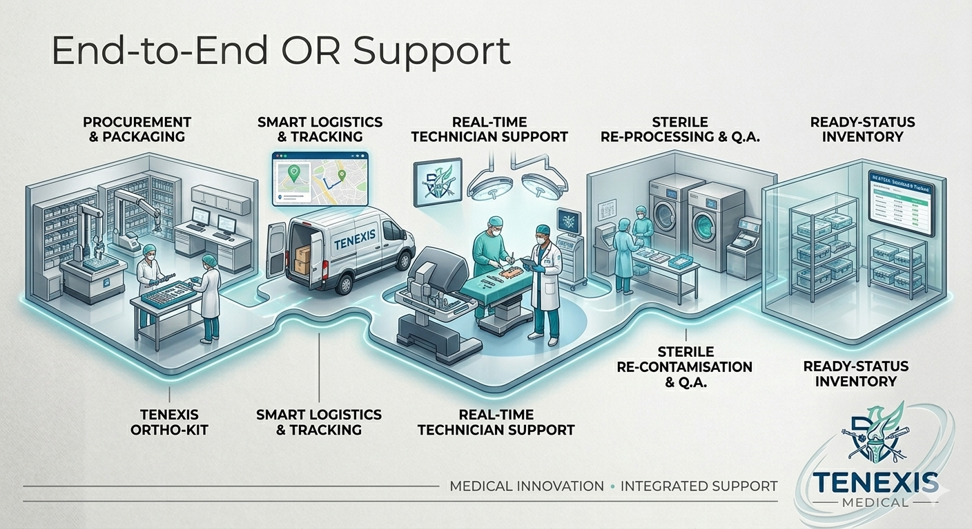
End-to-End OR Support
Live Technical Guidance: Expert technical coordinators inside the surgical suite to support precision tool and implant navigation.
Paramedical Training: Regular educational workflows for nurses and OR techs, minimizing setup slip-ups.
Post-Surgical Alignment: Seamless integration with physical rehabilitation insights for quicker recovery.
Optimized Timelines: Turning complex bone surgeries into efficient, highly standardized procedures.

Slide 10





Our Current Potential Suppliers

Slide 11

Rapidly Growing Market
52.8B
Global Orthopedic Implants Market
Highly Attractive Industry Tailwind
In 2026, the orthopedic sector is experiencing robust global demand, fueled by an aging population, rising osteoarthritis rates, and high sports injury frequencies.
With a healthy CAGR of 5.3%, the industry is projected to reach
$84.4 Billion by 2035. Tenexis is perfectly positioned to capture premium market share by offering localized clinical support, a differentiator that legacy providers consistently overlook.

Slide 12
Tenexis Roodmop to Exponsion
Q 1 2027
Acquire top clinical talent to scale high-performing operational support teams.
Q1 2028
Integrate specialized. hands-on recovery clinics to deliver true post-op patient care.
Q32026
Establish core headquarters and register Tenexis Medical
Q3 2027
Expand network multi-state. establishing key regional distribution warehouses.

Slide 13
Join Our Mission
tenexis2026@gmail.com
+91 96677 99507
Let's build the future of orthopedic clinical excellence together.

